Slide 1
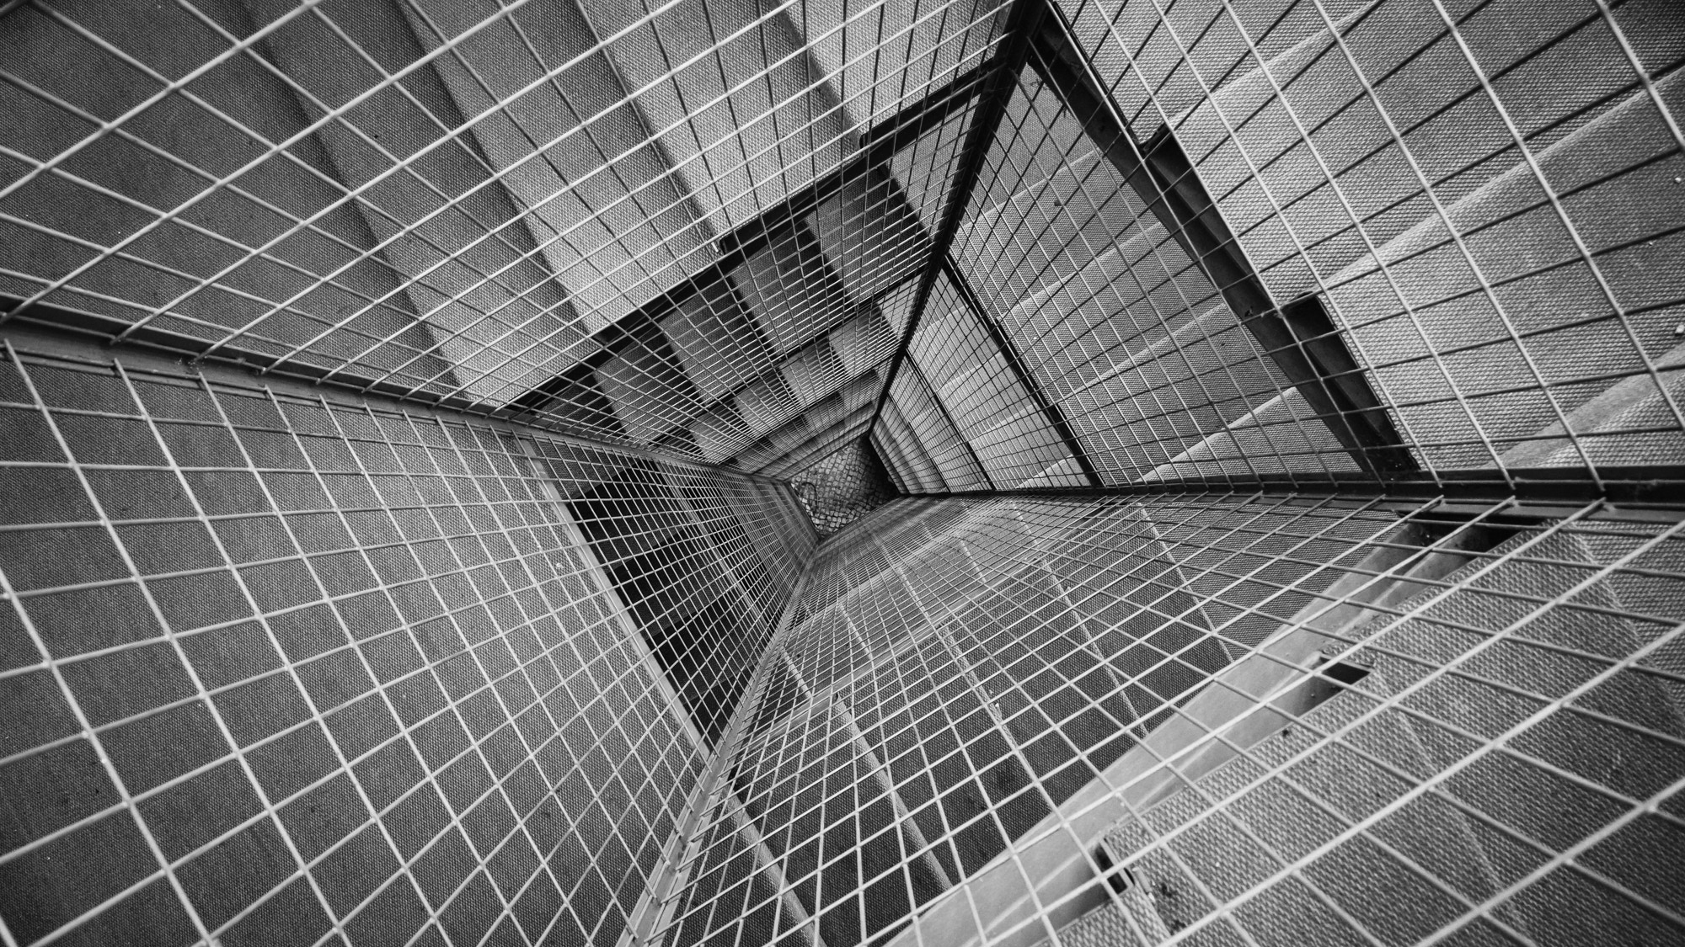
TOTAL TECHNOLOGY
REPORTLAB COMPLETE TUTORIAL
Table in Reportlab
Create table with alignment
Tutorial 29

Slide 2
How to create table with right alignment
from reportlab.platypus import Paragraph,SimpleDocTemplate,Table,TableStyle
from reportlab.lib import colors
pdf=SimpleDocTemplate("tutorial29.pdf")
flow_obj=[]
data=[[1,2,3,4,5],
[1,2,3,4,5],
[1,2,3,4,5]]
t=Table(data,colWidths=[40 for i in range(1,6)],rowHeights=[40 for i in range(1,4)])
tstyle=TableStyle([("BOX",(0,0),(-1,-1),1,colors.red),
("GRID",(0,0),(-1,-1),1,colors.blue),
("ALIGN",(0,0),(-1,-1),"RIGHT")])
t.setStyle(tstyle)
flow_obj.append(t)
pdf.build(flow_obj)
TOTAL TECHNOLOGY

Slide 3
How to create table with left alignment
from reportlab.platypus import Paragraph,SimpleDocTemplate,Table,TableStyle
from reportlab.lib import colors
pdf=SimpleDocTemplate("tutorial29.pdf")
flow_obj=[]
data=[[1,2,3,4,5],
[1,2,3,4,5],
[1,2,3,4,5]]
t=Table(data,colWidths=[40 for i in range(1,6)],rowHeights=[40 for i in range(1,4)])
tstyle=TableStyle([("BOX",(0,0),(-1,-1),1,colors.red),
("GRID",(0,0),(-1,-1),1,colors.blue)])
t.setStyle(tstyle)
flow_obj.append(t)
pdf.build(flow_obj)
TOTAL TECHNOLOGY

Slide 4
How to create table with center alignment
from reportlab.platypus import Paragraph,SimpleDocTemplate,Table,TableStyle
from reportlab.lib import colors
pdf=SimpleDocTemplate("tutorial29.pdf")
flow_obj=[]
data=[[1,2,3,4,5],
[1,2,3,4,5],
[1,2,3,4,5]]
t=Table(data,colWidths=[40 for i in range(1,6)],rowHeights=[40 for i in range(1,4)])
tstyle=TableStyle([("BOX",(0,0),(-1,-1),1,colors.red),
("GRID",(0,0),(-1,-1),1,colors.blue),
("ALIGN",(0,0),(-1,-1),"CENTER")])
t.setStyle(tstyle)
flow_obj.append(t)
pdf.build(flow_obj)
TOTAL TECHNOLOGY

Slide 5
How to create table with middle alignment
from reportlab.platypus import Paragraph,SimpleDocTemplate,Table,TableStyle
from reportlab.lib import colors
pdf=SimpleDocTemplate("tutorial29.pdf")
flow_obj=[]
data=[[1,2,3,4,5],
[1,2,3,4,5],
[1,2,3,4,5]]
t=Table(data,colWidths=[40 for i in range(1,6)],rowHeights=[40 for i in range(1,4)])
tstyle=TableStyle([("BOX",(0,0),(-1,-1),1,colors.red),
("GRID",(0,0),(-1,-1),1,colors.blue),
("VALIGN",(0,0),(-1,-1),"MIDDLE")])
t.setStyle(tstyle)
flow_obj.append(t)
pdf.build(flow_obj)
TOTAL TECHNOLOGY

